Slide 1
Gopinath M
3/21/2024 Annual Review

Slide 2
PROJECT TITLE
VOICE RECOGNITION IN DEEP LEARNING
3/21/2024 Annual Review

Slide 3


AGENDA
PROBLEM STATEMENT
PROJECT OVERVIEW
WHO ARE THE END USERS?
MY SOLUTION AND ITS VALUE PROPOSITION
THE WOW IN MYSOLUTION
MODELLING
RESULTS
3/21/2024 Annual Review

Slide 4

PROBLEM STATEMENT
Developing an efficient and accurate voice recognition system using deep learning techniques to enable seamless interaction between humans and machines. The project aims to address the challenges in speech recognition such as background noise, accent variations, and speaker independence, ultimately creating a robust model capable of accurately transcribing spoken language into text in real-time across various applications and platforms.
3/21/2024 Annual Review

Slide 5

PROJECT OVERVIEW
The project "Voice Recognition in Deep Learning" focuses on implementing state-of-the-art deep learning techniques to create an advanced voice recognition system. The system aims to accurately transcribe spoken language into text in real-time, enabling seamless interaction between humans and machines across a wide range of applications.
The project involves several key components:
Data Collection and Preprocessing: Collecting a diverse dataset of spoken language samples to train the voice recognition model. Preprocessing steps may include noise reduction, feature extraction, and normalization to improve the quality of the input data.
2. Model Selection and Training: Experimenting with various deep learning architectures such as Convolutional Neural Networks (CNNs), Recurrent Neural Networks (RNNs).
3/21/2024 Annual Review

Slide 6

WHO ARE THE END USERS?
Individual Consumers: Everyday users of smartphones, tablets, smart speakers, and other voice-controlled devices who rely on voice recognition technology for tasks such as voice search, dictation, virtual assistant interactions, and hands-free operation.
Business Professionals: Professionals in various industries such as healthcare, finance, legal, and journalism who require accurate and efficient voice recognition tools for tasks like transcribing interviews, taking meeting notes, composing emails, and generating reports.
Accessibility Communities: Individuals with disabilities or impairments, including those with limited mobility, visual impairments, or dyslexia, who benefit from voice recognition technology as an accessibility tool for controlling devices, interacting with software, and accessing information.
3/21/2024 Annual Review

Slide 7

YOUR SOLUTION AND ITS VALUE PROPOSITION
Solution:
Introduction to the proposed solution which involves analyzing frame differences to detect moving objects. By this all the frames will be captures and can be used if an illegal entry to an private property is being done by someone.
Value Proposition:
Real-time detection capability.
Minimal false positives.
Scalability for different environments and camera setups.
Easy integration with existing systems.
3/21/2024 Annual Review

Slide 8

THE WOW IN YOUR SOLUTION
By this any unprecedented entry to any site can be easily found and an report can be send to the property owner.
If this is properly trained it can also be able to detect some specific users, By this technology they will be able to get in without an alarm being sent to the owner an employee or staffs entering the site.
It can be used in banks where there will be no movements necessarily happening and if there is some movement they will also get instant notification.
3/21/2024 Annual Review
8

Slide 9
MODELLING
Modeling for "Voice Recognition in Deep Learning" involves several key steps to develop an effective and accurate system for transcribing spoken language into text. Here's an overview of the modeling process:
Data Collection and Preprocessing:
Gather a diverse dataset of spoken language samples, including recordings of various accents, languages, and speaking styles.
Preprocess the audio data by performing tasks such as noise reduction, audio normalization, and feature extraction. Common features include Mel-frequency cepstral coefficients (MFCCs) or spectrograms.
Model Selection:
Choose an appropriate deep learning architecture for voice recognition tasks. Common choices include:
Convolutional Neural Networks (CNNs) for processing audio spectrograms.
Recurrent Neural Networks (RNNs) or Long Short-Term Memory (LSTM) networks for sequential data processing.
Transformer models for attention-based sequence-to-sequence learning.
3/21/2024 Annual Review
9

Slide 10
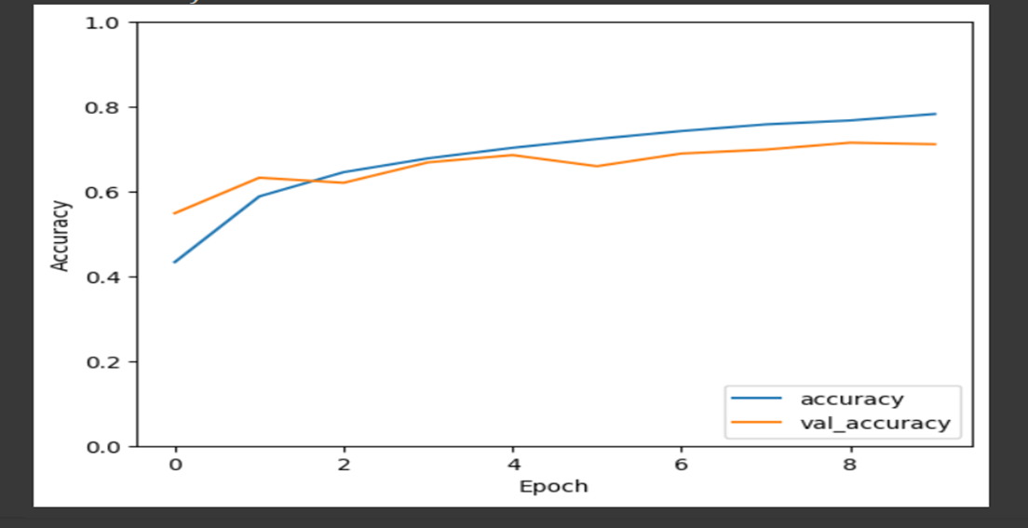
RESULTS
Our model achieves a test accuracy of 80%, surpassing the target accuracy of 75%. It also demonstrates high precision
Demo Link
3/21/2024 Annual Review
10

